Slide 1
Software Quality Engineering
Lecture 01

Slide 2
What is quality?
Quality is not absolute.
Quality is multidimensional
Quality is subject to constraints
Quality is about Acceptable Compromises
Quality criteria are not independent

Slide 3
Quality
“The totality of features and characteristics of a product or service that bears on its ability to satisfy specified or implied needs. ”

Slide 4
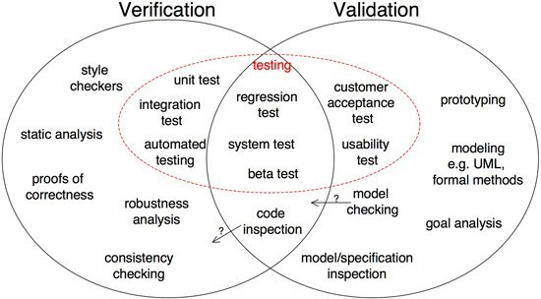
Validation & Verification

Slide 5
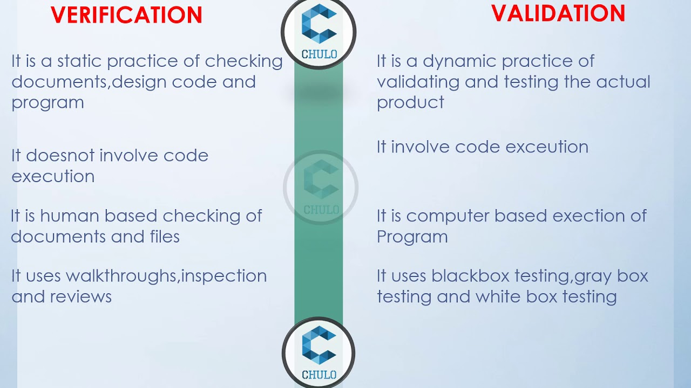

Slide 6
Main Tasks of Quality Engineering
Quality Planning
Execution of selected QA or Software validation and verification activities;
Measurements and analysis to provide convincing evidence to demonstrate software quality to all parties involved.

Slide 7
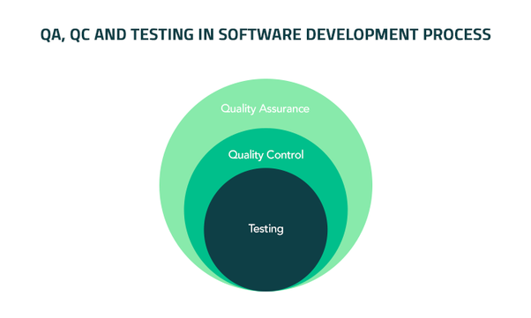
Testing, Quality Assurance and Quality Engineering

Slide 8
Testing, Quality Assurance and Quality Engineering
Software Testing
  Testing with different types of general checklist
  Decision and Predicate Testing
  Usage-based statistical testing using flat operational profiles.
  Boundary Testing
  State-based Testing
  Interaction Testing
    Control Flow Testing
    Data Flow Testing

Slide 9

Quality Assurance Beyond Testing
Techniques for defect prevention
Root Cause Analysis for Defect Prevention
  Analysis and Modeling for defect prevention
  Technologies, standards and methodologies for defect prevention.
  Software Tools to block defect injection

Slide 10
Software Quality Engineering
Software quality engineering (SQE) is the application of QE practices to the software development lifecycle (SDLC).
In software quality engineering, QE is closely integrated with existing agile and develop processes, as opposed to being added as a layer on top of existing workflows.
This mirrors the shifted-left testing principles of DevSecOps teams and is intended to identify issues early on.

Slide 11
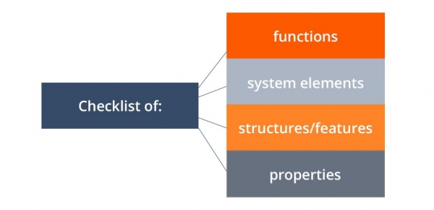
Elaborating of Testing Types Discussed
Checklist Testing
Checklist-based testing is a type of software testing based on the pre-planned “to-do” list of tasks called a checklist. Professional testers, who have sufficient technical experience usually complete these lists. QA (Quality Assurance) engineers use such checklists to guide the testing activities.

Slide 12
Boundary Testing
Boundary testing is the process of testing between extreme ends or boundaries between partitions of the input values.
So these extreme ends like Start- End, Lower- Upper, Maximum-Minimum, Just Inside-Just Outside values are called boundary values and the testing is called "boundary testing".

Slide 13
Usage Based Testing
Usage-based statistical testing is commonly appropriate to the final phase of software testing, normally referred to as acceptance testing right before product release, so that stopping testing is of equal worth to the product release.

Slide 14
State Based Testing
State-based testing is a new method for testing object-oriented programs. The information stored in the state of an object is of two kinds: control-information and data-storage.

Slide 15
Control Flow Testing
Control flow testing is a testing technique that comes under white box testing.
The aim of this technique is to determine the execution order of statements or instructions of the program through a control structure.
The control structure of a program is used to develop a test case for the program.

Slide 16
Data Flow Testing
Data Flow Testing is a specific strategy of software testing that focuses on data variables and their values. It makes use of the control flow graph.
When it comes to categorization Data flow testing will can be considered as a type of white box testing and structural types of testing.

Slide 17
Goals of SQE
The primary goals of software quality engineering are:
Process control and oversight
Implementing standards and metrics
Data collection and analysis
Test development
Identification of issues and solutions
Follow-up to ensure corrective actions

Slide 18
Quality Concerns
Quality analysts are typically responsible for:
  Sprint, test, and release planning.
  Serving as a quality testing expert.
  Managing backlogs to avoid oversight of acceptance criteria or edge cases
  Executing functional tests.
  Reporting on quality and testing status.
  Maintaining quality documentation.
  Identifying test cases.
  Working with client teams to support acceptance testing, analyze issues, and classify issues as bugs or enhancements.
  Manually configuring test environments

Slide 19
Quality engineers Responsibilities
Quality engineers are typically responsible for:
  Identifying repeated test cases.
  Identifying tests requiring multiple environments, such as browsers or operating systems.
  Identifying end-to-end test cases.
  Automating tests to eliminate issues related to manual testing.
  Integrating testing into continuous integration / continuous delivery (CI/CD) pipelines.
  Identify and resolve bugs resulting from test automation failures.

Slide 20
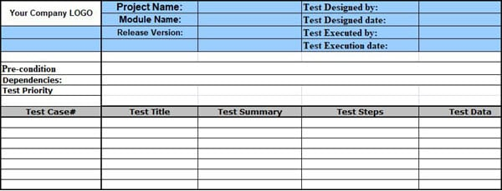
Test case Formate

Slide 21
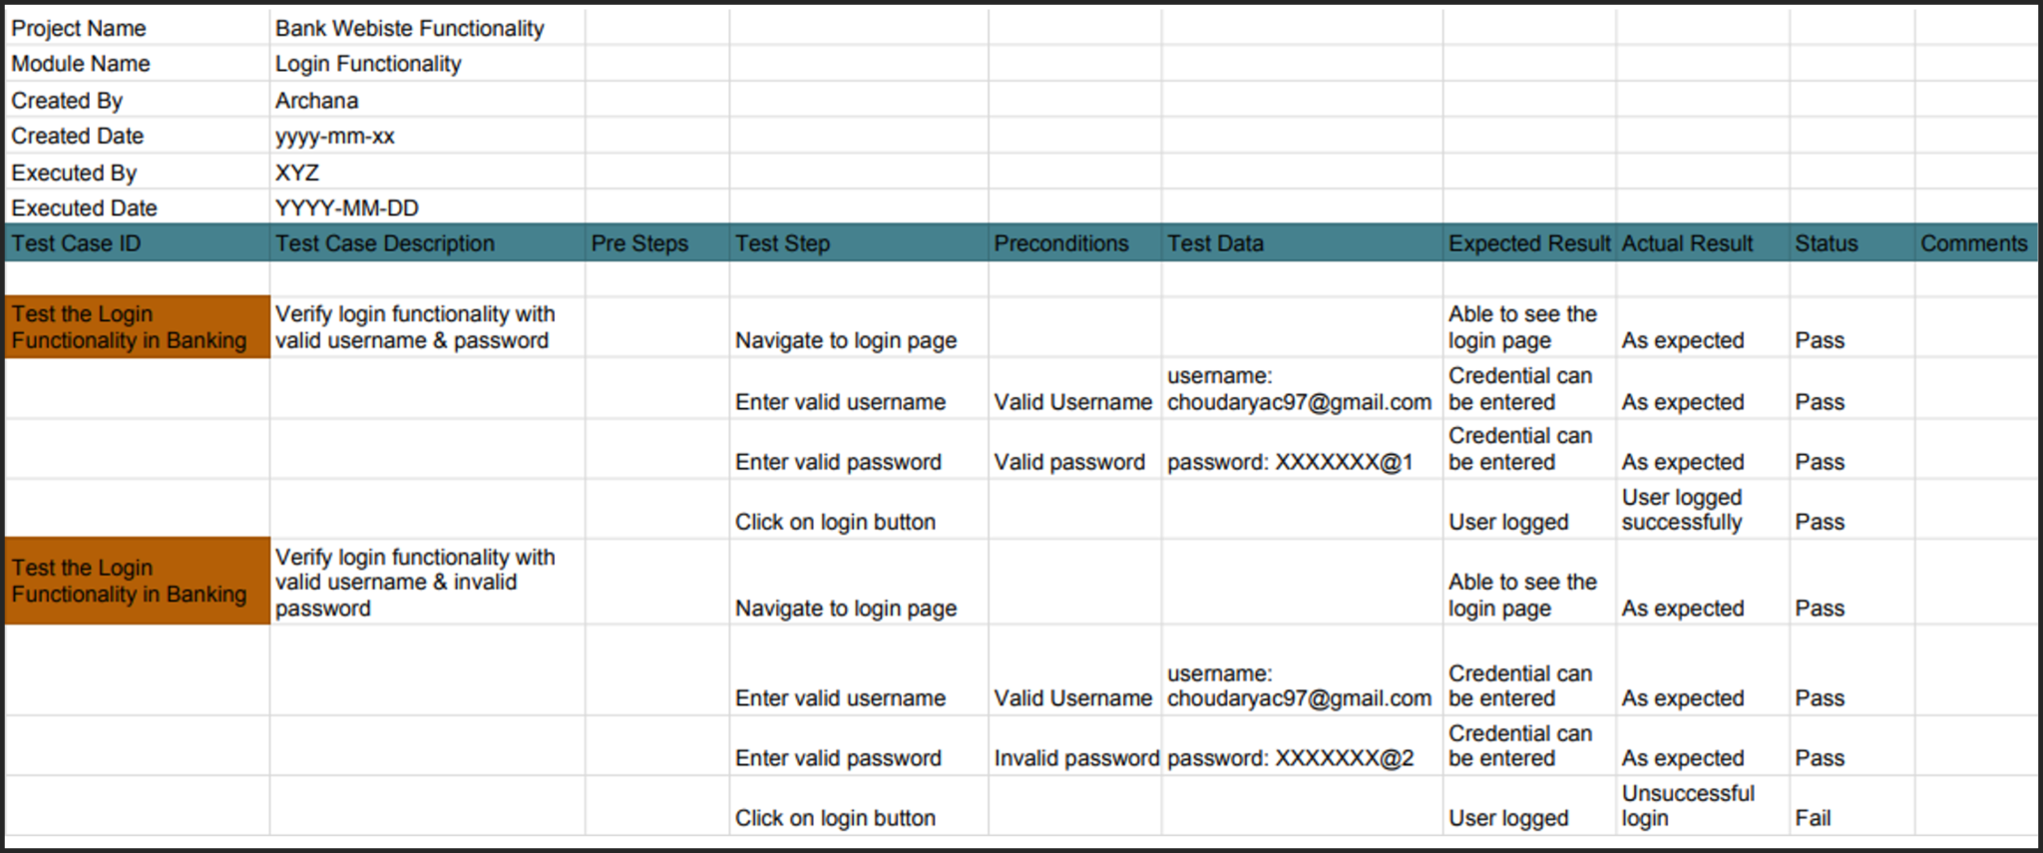
Example:

Slide 22
E2E Test Case
End to end testing (E2E testing) refers to a software testing method that involves testing an application's workflow from beginning to end.
This method basically aims to replicate real user scenarios so that the system can be validated for integration and data integrity.

Slide 23
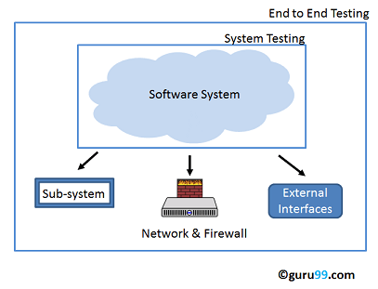
Example

